Slide 1
Properties and Structures of Atoms
Atoms – basic particles which make up matter and cannot be broken down by chemical means. They are composed of protons, neutrons and electrons.
Protons – positively charged particles found in the nucleus of an atom
Neutrons – neutral particles found in the nucleus of an atom
Electron – negatively charged particles found in the electron cloud orbiting the nucleus.

Slide 2
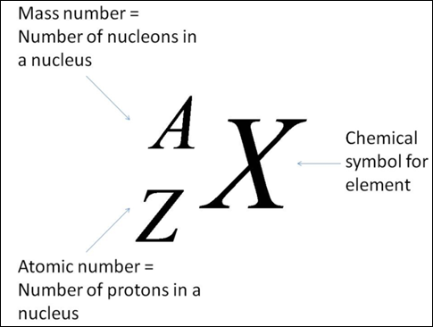
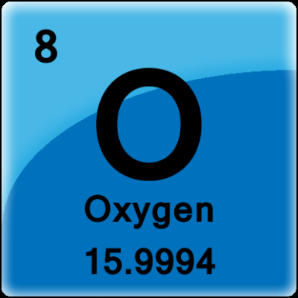
Mass number – the number of protons plus neutrons in an atom. Given the symbol A
Atomic number – the number of protons in an atom. Given the symbol Z
Traditional
(Chen, 2011)
Periodic Table
(Helmenstine, 2014)

Slide 3
Cations – atoms which have lost electrons to produce a positively charged ion. For example Ca²⁺, Cr⁶⁺, etc.
Anions – atoms which have gained electrons to produce a negatively charged ion. For example O²⁻, P³⁻, etc.

Slide 4
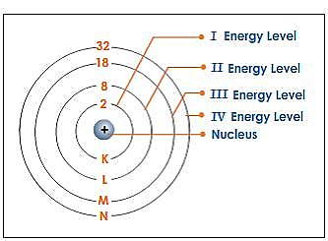
Electrons are located in distinct energy levels around the nucleus.
Energy levels are numbered 1, 2, 3, 4, etc from closest to the nucleus outwards.
(Tangient LLC nd)

Slide 5
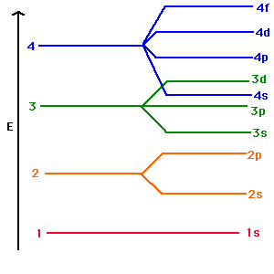
Each energy level can hold a maximum of 2n² electrons where n is the energy level.
Energy-wise, it is not efficient to fill each energy level completely before moving onto the next level. This does occur in the first two energy levels but from then on, it follows the following order:
(Tangient LLC nd)

Slide 6
1₂
2₂
2₆
3₂
3₆
3₁₀
4₂
4₆
4₁₀
4₁₄
5₂
5₆
5₁₀
5₁₄
6₂
6₆
6₁₀
7₂

Slide 7
Energy Levels | Number of Sub-Levels (Orbitals) | Total Number of Electrons (2n²) | Electrons per Sub-Level
1 | 1 | 2 | 2
2 | 2 | 8 | 2,6
3 | 3 | 18 | 2,6,10
4 | 4 | 32 | 2,6,10,14
5 | 5 | 32 | 2,6,10,14

Slide 8
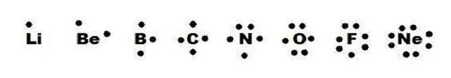
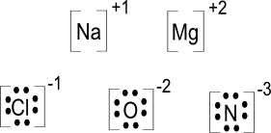
When atoms form ions, they will tend to gain or lose electrons to obtain the electron configuration of their nearest noble gas (which are very stable).
As noble gases have 8 valence electrons (except He), when atoms gain or lose electrons to attain a noble gas configuration they are trying to fulfill the octet rule.
Lewis structures are diagrams showing the number of valence electrons (only) in an atom or ion.
(AA nd)
(AA nd)

Slide 9
Atomic Model Timeline
610-322 BC – Anaximander of Miletus, Plato and Aristotle propose matter consists of four elements (fire, water, earth and air)
460-370 BC – Democritus proposes matter consists of tiny indivisible particles called atomos
1789 – Lavoisier develops law of conservation of mass (mass of reactants is equal to mass of products in a chemical reaction)
1794 – Proust proposes law of definite proportions (different samples of the same compound always contain the elements in the same proportion by mass)

Slide 10
1803-1808 – Dalton presents his atomic theory
Elements are composed of tiny particles called atoms
All atoms of the same element are identical
Atoms are not created, destroyed nor changed during a chemical reaction
A chemical reaction involves only separation, combination or rearrangement of atoms
Compounds are formed by atoms from different elements combining in a specific ratio

Slide 11
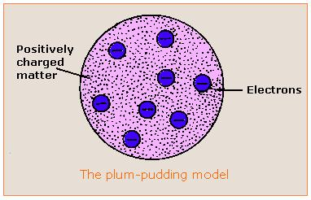
1897 – Thomson uses cathode ray tube (CRT) to discover electrons and to conclude that atoms are divisible
1904 – Thomson proposes a ‘plum-pudding’ model of the atom where electrons are embedded within a sphere of positive charge.
1909 – Millikan used his oil drop experiment to determine the charge and mass of an electron
(Yost nd)

Slide 12
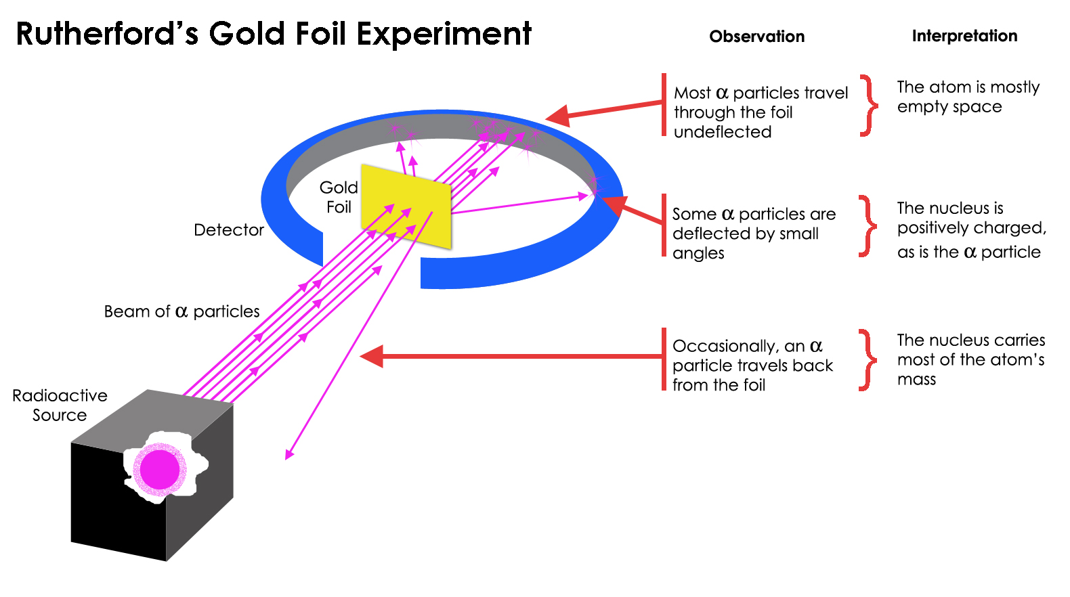
1909-1913 – Rutherford bombarded gold foil with alpha particles and concludes that atoms are made up of mostly space with a nucleus at the centre and the electrons orbiting the nucleus
(Impey 2014)

Slide 13
Bohr’s Model of the Atom
1932 – Chadwick identifies neutrons
1913 – Neils Bohr uses quantum theory to propose that electrons move around the nucleus in orbits with specific amounts (quanta) of energy.
When electrons are in their lowest energy orbits, they are said to be in their ground state.
The electrons can gain specific quanta of energy to move to a higher orbital (the atom is now in an excited state) and release this specific quanta of energy to return to the ground state. Different elements absorb and emit different quanta of energy.

Slide 14
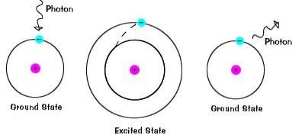
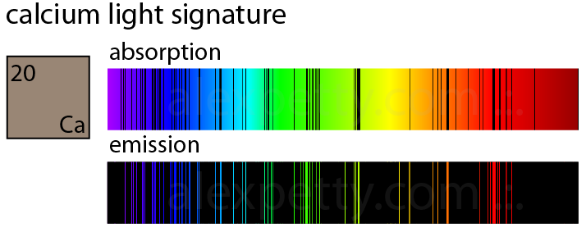
(na nd)
This theory explained emission and absorption spectra.
(na Calcium Emission Spectrum nd)

Slide 15
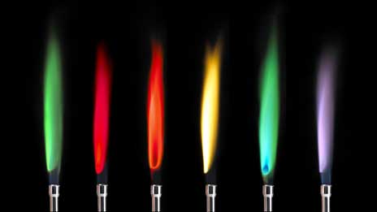
Emission Spectrum – formed when a sample of the element absorbs energy (usually heat or electrical). The electrons jump up to higher energy levels but then immediately will drop back down to their original energy level. As the excited electrons return to their ground state they emit the energy they absorbed in the form of photons of light of specific wavelengths (different colours). Flame tests use this concept.
(BBC 2014)

Slide 16
When the barium ions are heated, the electrons absorb energy and jump up to higher energy levels. (1) As this state is unstable, the electrons eventually fall back down to their original levels and in doing so emit the energy they absorbed in the form of photons of light. (1) The wavelength of these photons corresponds to the wavelength of green coloured light. (1)

Slide 17
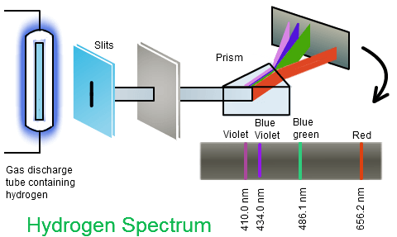
(NCS Pearson 2014)

Slide 18
Absorption Spectrum – formed when a sample of the element absorbs energy from a light source and as the ground state electrons absorb this particular wavelength of energy a detector measures its absence (seen as a black line). Atomic absorption spectroscopy (AAS) uses this concept to determine the concentration of a known element in a sample.

Slide 19
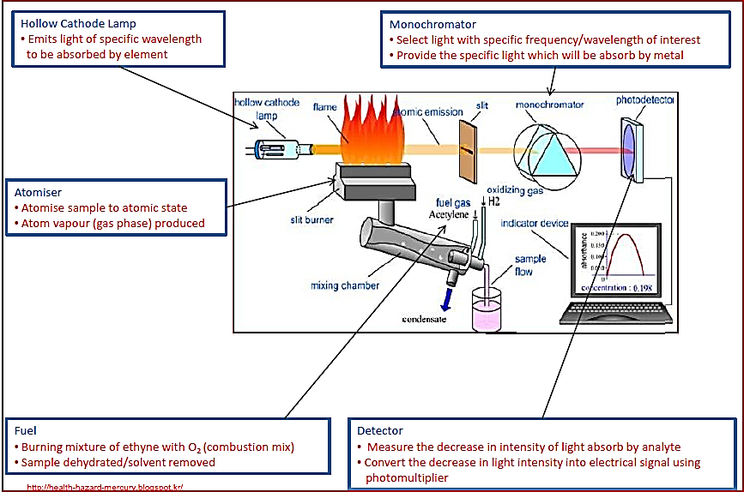
(Kok 2012)

Slide 20
AAS
A solution containing the sample is first atomised in a hot flame.
A beam of light corresponding to the wavelength(s) of the sample is passed through the atomised sample in the flame. To achieve this, the beam of light is produced by a hollow cathode lamp where the cathode is made from the same element as that being analysed.
Wavelength filter (monochromator) then filters out other wavelengths of light emitted (removing noise) except the one specific wavelength being analysed.
Detector determines the intensity of the light being received. The absorbance is the difference between the intensity of light emitted by the hollow cathode lamp and the intensity being detected. It is proportional to the concentration of the sample in the solution.

Slide 21
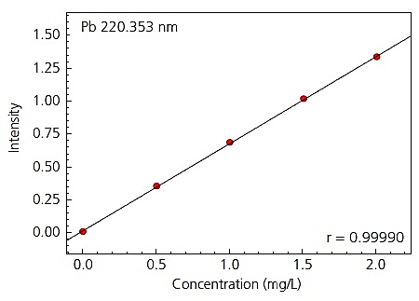
AAS can be used to determine the unknown concentration of a particular element in a sample using a calibration curve.
(AZom 2012)

Slide 22
Just as the location and number of electrons in a sample can be used to determine its identity and/or concentration, the location of electrons give us clues to its bonding capacity.
Remember an atom will tend to gain or lose electrons to obtain a stable, full valence shell. Eg Sr (2, 8, 18, 8, 2) loses two electrons to become Sr²⁺ (2, 8, 18, 8), I (2,8,18,18,7) gains one electron to become I— (2, 8, 18, 18, 8). This is the ionic bonding capacity.
In covalent molecular and network substances, atoms tend to share electrons to gain full valence shells

Slide 23
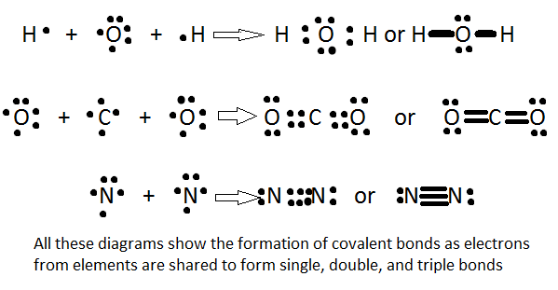
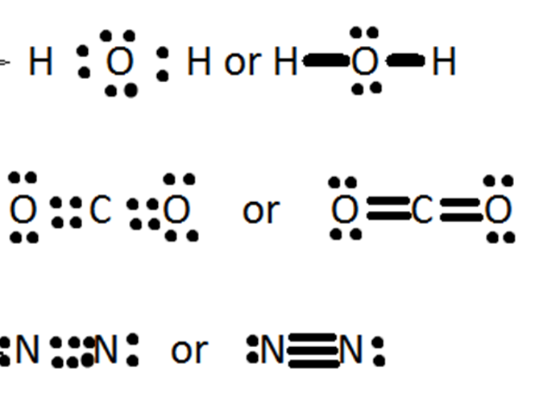
In covalent molecular and network substances, atoms tend to share electrons to gain full valence shells. In general, the number of electrons they need will determine the maximum number of bonds they can form. Eg N (2,5) needs 3 e— so forms up to 3 bonds, Br needs 1 e— so forms 1 bond, etc. This is the covalent bonding capacity.
(Nguyen nd)

Slide 24
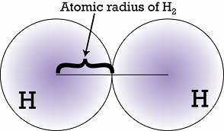
Periodic Table Trends
Atomic radius
Half the distance between two nuclei of the same element
(dkeith-jasd 2014)

Slide 25
Atomic Radius
Decreases across the period – atoms of elements in the same period have the same number of electron shells. As you move across the period the nuclear charge increases and the electron shells are pulled in closer to the nucleus.
Increases down a group – each time you go down a period in the group, electrons are added to a new electron shell which is further from the nucleus.

Slide 26
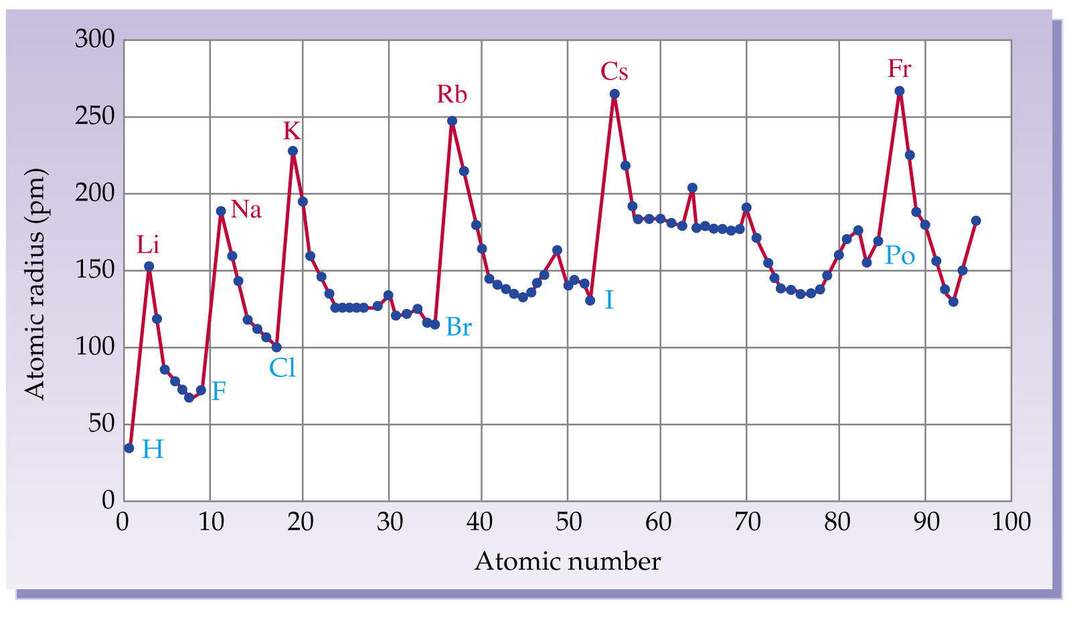
(Prentice-Hall Inc 2004)

Slide 27
First ionisation energy – the energy required to remove the outermost electron from a gaseous atom
Li_{(g)} + E₁ → Li⁺_{(g)} + e—
Increases across a period
As you move across a period, the nuclear charge is increasing and the atomic radius is decreasing. The electrons are therefore attracted to the nucleus more strongly and so ionisation energy increases.
Decreases down a group
As you move down a group, the outer electrons are in higher energy levels so they are further from the nucleus and there is also a greater shielding effect by the inner electrons on them. The outer electrons are therefore not attracted to the nucleus as strongly and so ionisation energy decreases.

Slide 28
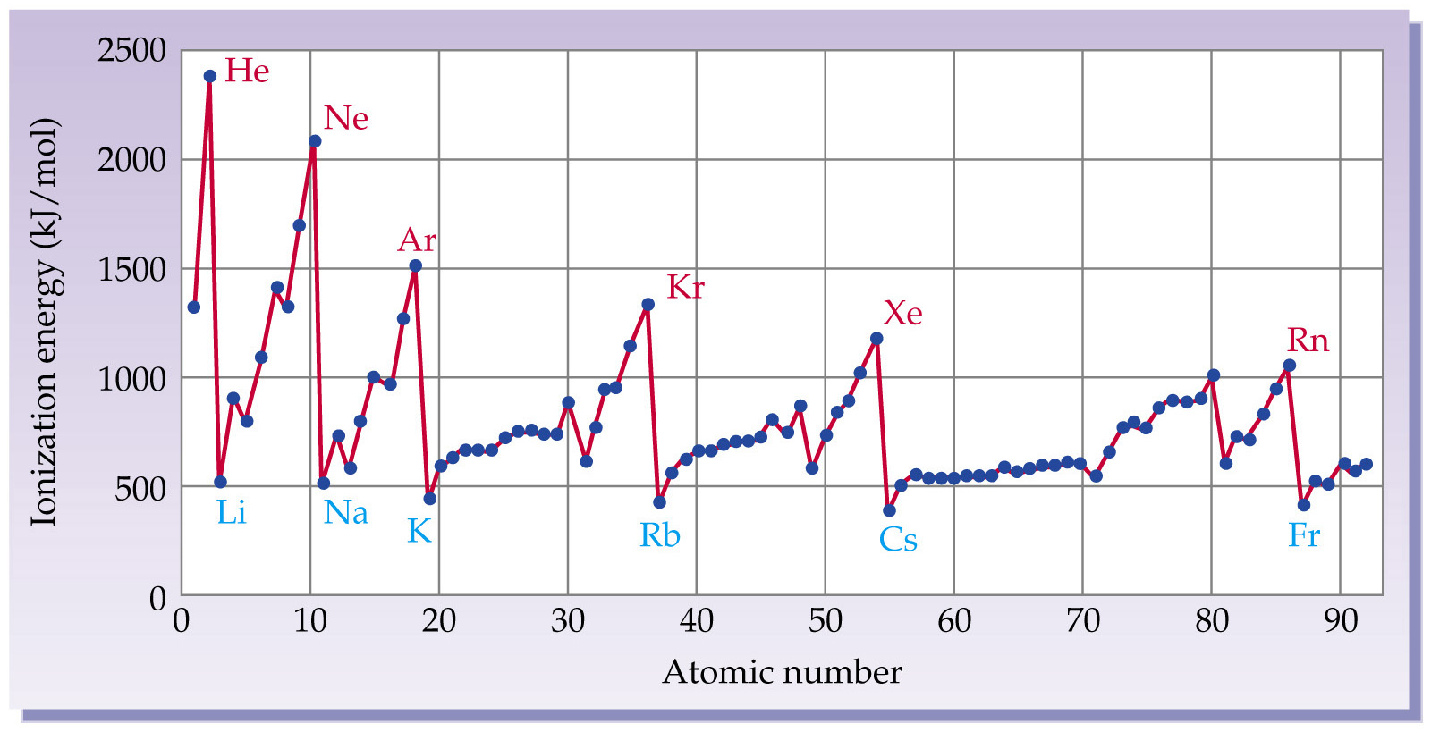
(Disqus nd)

Slide 29
Ionisation energy data can give us information about the electronic configuration of an element.
Eg Below are ionisation energies for sodium.
Electron | Ionisation Energy (MJ mol⁻¹)
1 | 0.495
2 | 4.56
3 | 6.91
4 | 9.54
5 | 13.3
6 | 16.6
7 | 20.1
8 | 25.5
9 | 28.9
10 | 141.4
11 | 159.0

Slide 30
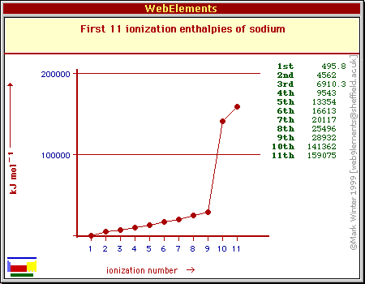
(Winter 2004)
From this it can be seen that there is a large increase in the ionisation energy each time a new shell (closer to the nucleus) is begun.

Slide 31
Electronegativity– the ability of an atom to attract electrons to itself.
Increases across a period
As you move across a period, the nuclear charge is increasing and the atomic radius is decreasing. The electrons are therefore attracted to the nucleus more strongly and so electronegativity increases.
Decreases down a group
As you move down a group, the outer electrons are in higher energy levels so they are further from the nucleus and there is also a greater shielding effect by the inner electrons. The electrons are therefore not attracted to the nucleus as strongly and so electronegativity decreases.

Slide 32
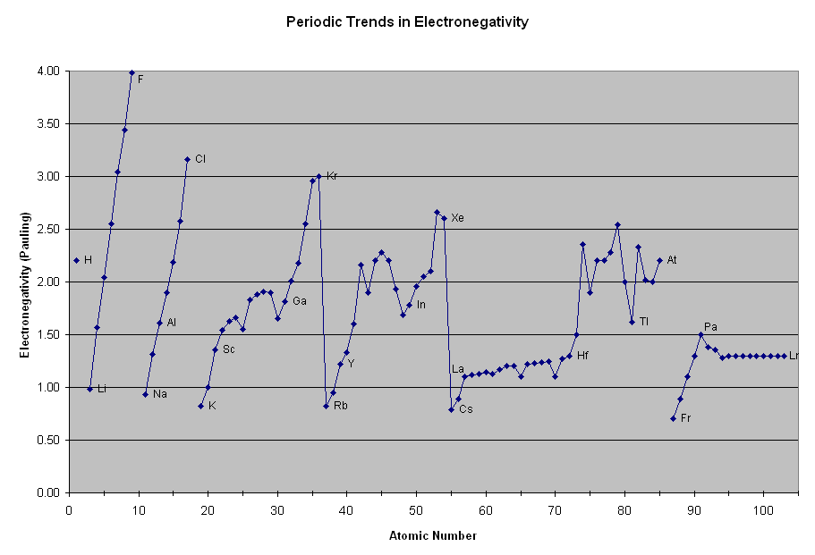
(NA nd)

Slide 33
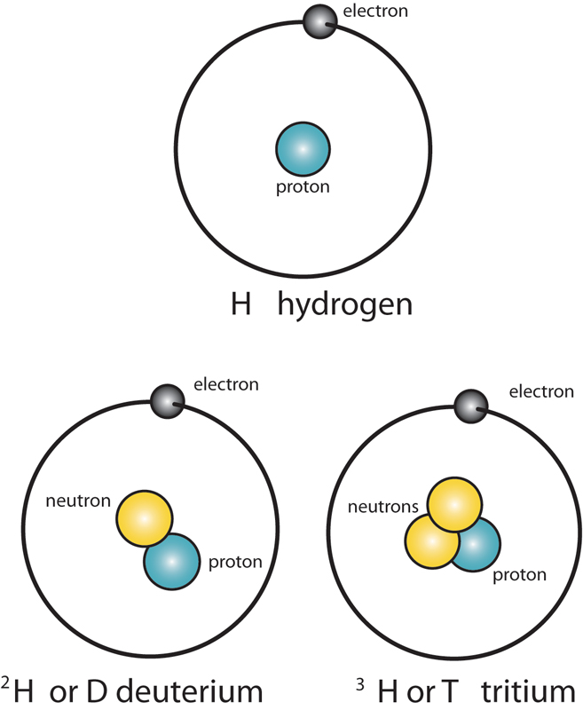
Isotopes
Isotopes – atoms with the same number of protons but different numbers of neutrons. For example hydrogen-1, hydrogen-2 and hydrogen-3.
Similar chemical properties but differ in mass, physical properties and radioactivity.
(Linda Hall Library nd)

Slide 34
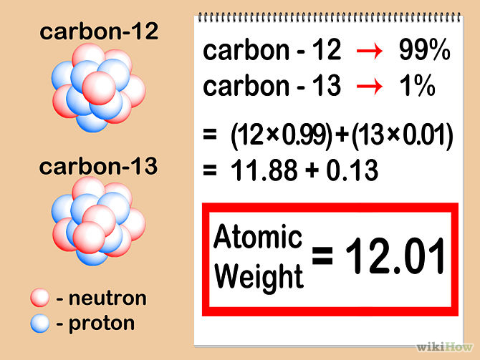
Can be represented as carbon-14, C-14 or ¹⁴C
Isotopes are taken into account when calculating relative atomic masses.
Relative atomic mass (A_{r}) is the ratio of the average mass of the atom compared to 1/12th the mass of ¹²C.
The relative atomic masses of the elements are calculated from their isotopic composition
(Mediawiki nd)

Slide 35
The following formula can be used
A_{r} = (%a/100)×A_{r}(a) + (%b/100)×A_{r}(b)
Where
%a = percentage of isotope a in the element
A_{r}(a) = relative atomic mass of isotope a
%b = percentage of isotope b in the element
A_{r}(b) = relative atomic mass of isotope b
Eg Cu consists of 69.15% Cu-62.93 and 30.85% Cu-64.93. Calculate the relative atomic mass of Cu.
Example 1, p9 in student booklet

Slide 36
The following formula can be used to calculate the relative percent of each isotope
A_{r} = (X)×A_{r}(a) + (1-X)×A_{r}(b)
Where
X = the percentage (expressed as a fraction) of isotope a in the element
A_{r}(a) = relative atomic mass of isotope a
A_{r}(b) = relative atomic mass of isotope b
Eg Calculate the relative abundance of Al-28 and Al-26 if it has a relative atomic mass of 26.98.
Example 2, p9 in student booklet

Slide 37
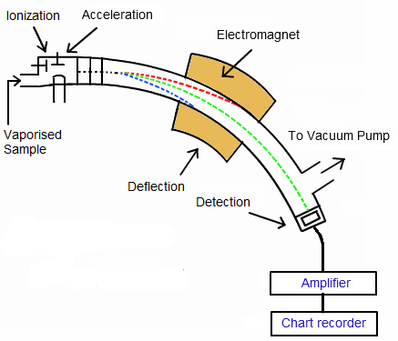
Mass Spectrometry
Mass spectrometry can be used to determine the identity of compounds or elements in a sample or to determine the isotopic composition of an element
(NCS-Pearson 2014)

Slide 38
Five main processes involved in mass spectrometry:
Vaporisation – sample is made gaseous in a vacuum chamber
Ionisation – gaseous sample is bombarded by electrons which causes it to form ions (mostly +1 but some +2)
Acceleration – ions are accelerated through an electric field
Deflection -ions then move into a magnetic field where they are deflected based on their mass to charge ratio; heavier ions are deflected less.
Detection – detector measures the number of ions of different mass (based on intensity and radius of deflection of ions)

Slide 39
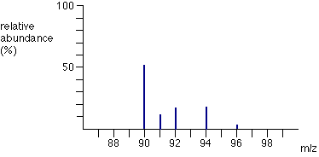
A mass spectrum is a graphical representation of the relative abundance of isotopes present in a sample.
Mass Spectrum for Zirconium
(Clark 2000)
Example 3, p11 student booklet

Slide 40
Percentage Composition and Empirical Formula
Percentage composition of a compound can be calculated using the relative atomic masses of the elements in the compound using the formula
%element = (∑A_{r}(element)/A_{r}(compound))×100
Eg Calculate the percentage composition of K₂CrO₄.
% K = (2×A_{r}(K)/A_{r}(K₂CrO₄)) ×100
= ((2×39.1)/194.2) ×100
= 40.27%

Slide 41
% Cr = (A_{r}(Cr)/A_{r}(K₂CrO₄)) ×100
= ((52.00)/194.2) ×100
= 26.78%
%O = (4 × A_{r}(O)/A_{r}(K₂CrO₄)) ×100
= ((4×16.00)/194.2) ×100
= 32.96%
Double check: 40.27+26.78+32.96 = 100.01
Example 4, p12 in student booklet
Can also use masses
Example 5, p12 in student booklet

Slide 42
Empirical formula is the simplest whole number ratio of elements in a compound.
Molecular Formula | Empirical Formula
H₂O₂ | HO
C₄H₈O₂ | C₂H₄O
SrCr₂O₇ | SrCr₂O₇
CH₃COOH | CH₂O
H₂O | H₂O
C₁₂H₉N₃O₆ | C₄H₃N₁O₂
Empirical formula can be calculated if the mass percentage of each element is known

Slide 43

Eg Calculate the empirical formula of a compound that contains 93.18% silver and 6.82% oxygen.
 | Ag | O
% | 93.18 | 6.82
mass in 100g (g) | 93.18 | 6.82
n (mol) | 93.18/107.9 | 6.82/16.00
= | 0.863577386 | 0.42625
Ratio | ÷ 0.42625 | ÷ 0.42625
≈ | 2.03 | 1.00
Round | 2 | 1
$∴$ Empirical formula = Ag₂O

Slide 44
Example 1
The following formula can be used
A_{r} = (a×A_{r}(a)) + (b×A_{r}(b))
A_{r} = (0.802×11) + (0.198×10)
= 10.8
Where
A_{r} = relative atomic mass
a = percentage of isotope a as a decimal
b = percentage of isotope b as a decimal

Slide 45
Example 2
A_{r} = (%a/100)×A_{r}(a) + (%b/100)×A_{r}(b)
63.55 = (x × 63)+ ((1-x) × 65)
63.55 = (63x/100) + (6500-65x/100)
63.55 = 63x + 65 – 65x
63.55 -65 = 63x– 65x
-1.45 = -2x
x= 0.725
72.5% of Cu -63
27.5% of Cu-65

Slide 46
Bibliography
AA. "Lewis Structures." apchemcyhs. nd. http://apchemcyhs.wikispaces.com/Lewis+Structures (accessed February 4, 2015).
AZom. "Measurement of Lead in Lead-Free Solder." AZO Materials. October 25, 2012. http://www.azom.com/article.aspx?ArticleID=7678 (accessed February 8, 2015).
BBC. "Qualitative Analysis." GCSE Bitesize. 2014. http://www.bbc.co.uk/schools/gcsebitesize/science/triple_edexcel/qualitative_analysis/qualitative_analysis/revision/2/ (accessed February 7, 2015).
Chen, I-Tso. "The Liquid Drop Model." The Liquid Drop Model. February 13, 2011. http://large.stanford.edu/courses/2011/ph241/chen1/ (accessed January 11, 2015).
Clark, Jim. "The Mass Spectra of Elements." Chem Guide - Helping You to Understand Chemistry. 2000. http://www.chemguide.co.uk/analysis/masspec/elements.html (accessed February 17, 2015).
Disqus. "Ionization Energy Values." Galleryhip.com. nd. http://galleryhip.com/ionization-energy-values.html (accessed February 8, 2015).
dkeith-jasd. "Atomic Radius." JAHS Chem. January 21, 2014. https://jahschem.wikispaces.com/atomic+radius (accessed February 8, 2015).
Helmenstine, A M. "Isotopes and Nuclear Symbols." About Education. December 4, 2014. http://chemistry.about.com/od/workedchemistryproblems/a/isotopes-nuclear-symbols-1.htm (accessed January 11, 2015).
Impey, Chris. "The Structure of the Atom." Teach Astronomy. 2014. http://www.teachastronomy.com/astropedia/article.aspx?qid=426 (accessed February 4, 2015).
Kok, Lawrence. "IB Chemistry on Atomic Absorption Spectroscopy and Beer Lambert Law." IB Biology/Chemistry. October 19, 2012. http://lawrencekok.blogspot.com.au/2012/10/ib-chemistry-on-atomic-absorption.html (accessed February 8, 2015).
Linda Hall Library. "The Atomic Age." It's a Question of Physics: What is an Isotope. nd. http://atomic.lindahall.org/what-is-an-isotope.html (accessed Febraury 2, 2015).
McAfoos, L. "Lewis Dot Structures of Atoms and Ions." A Better Chem Text.com. 2009. http://abetterchemtext.com/Bonding/LDS_atoms.htm (accessed February 4, 2015).
Mediawiki. "How to Calculate Atomic Mass." WikiHow to do Anything. nd. http://www.wikihow.com/Calculate-Atomic-Mass (accessed Febraury 17, 2015).
na. "Calcium Emission Spectrum." Pixgood.com. nd. http://pixgood.com/calcium-emission-spectrum.html (accessed February 7, 2015).
—. "Notes: Chapter 11." nd. http://www.kmacgill.com/lecture_notes/lecture_notes_11_12.htm (accessed February 4, 2015).
NA. "Periodic Trends - Electronegativity." The Parts of the Periodic Table. nd. http://www.angelo.edu/faculty/kboudrea/periodic/trends_electronegativity.htm (accessed February 17, 2015).
NCS Pearson. "Spectral Lines." Tutorvista.com. 2014. http://chemistry.tutorvista.com/inorganic-chemistry/spectral-lines.html (accessed February 7, 2015).
NCS-Pearson. "Biomolecules." Tutorvista.com. 2014. http://chemistry.tutorvista.com/analytical-chemistry/biomolecules.html (accessed February 17, 2015).
Nguyen, Emily. "Introduction to Chemical Bonding." UC Davis Chemwiki. nd. http://chemwiki.ucdavis.edu/Physical_Chemistry/Quantum_Mechanics/09._The_Hydrogen_Atom/Atomic_Theory/Chemical_Compounds/Introduction_to_Chemical_Bonding (accessed February 8, 2015).
Prentice-Hall Inc. "Chapter 5 Periodicity and Atomic Structure." Key Concepts PowerPoint. 2004. http://wps.prenhall.com/wps/media/objects/602/616516/Chapter_05.html (accessed February 8, 2015).
Tangient LLC. "Line Spectra, Electron Shells and Energy Level Diagrams ." Mr Standring'sWiki for Chemistry 11. nd. https://chemistry11mrstandring.wikispaces.com/LIine+spectra,+electron+shells+and+energy+level+diagrams (accessed Febraury 2, 2015).
Winter, Mark. "Sodium." Chemistry: Periodic Table. April 18, 2004. http://jpkc.whut.edu.cn/web18/main/wangluo/webelements/webelements/elements/text/na/ionz.html (accessed February 18, 2015).
Yost, Alicia. "History of the Atom." Science in Your Everday Life. nd. http://yostscience.weebly.com/history-of-the-atom.html (accessed February 4, 2015).

